Slide 1

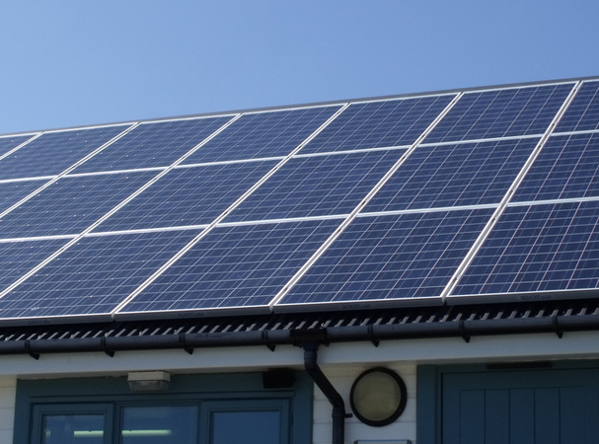
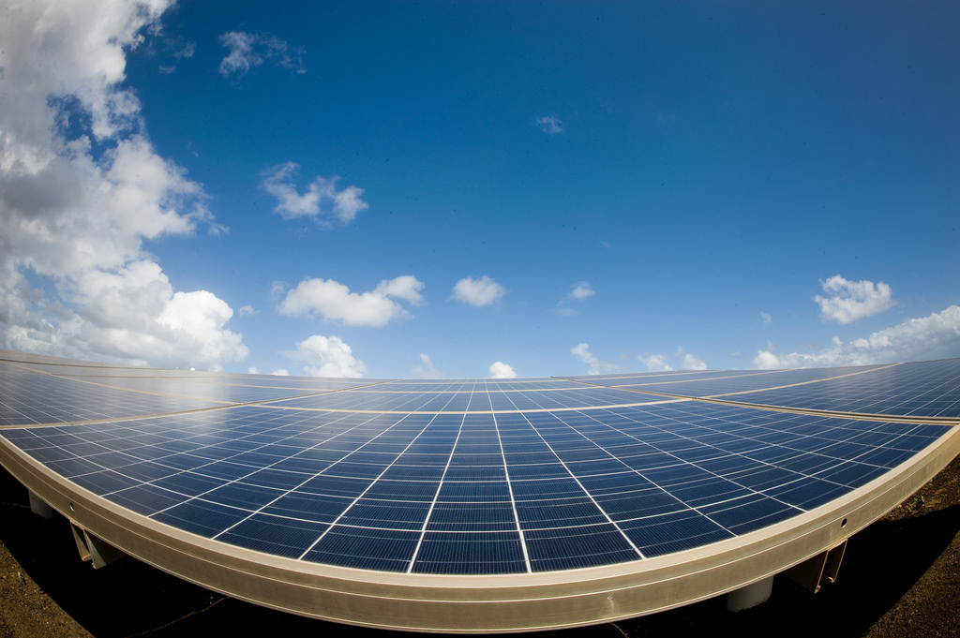
Final Project: Why Go Solar
This Photo by Unknown Author is licensed under CC BY-ND
UC Berkeley Data Analytics
Bootcamp Final Project
This Photo by Unknown Author is licensed under CC BY
This Photo by Unknown Author is licensed under CC BY

Slide 2
Team Sunny Day
Jacob Zebker
Kellen Schmitz
Chung In Ngan
Angela Kumar
Team SunnyDay: Jacob Zebker, Kellen Schmitz, Chung In “Angel” Ngan, Angela Kumar

Slide 3
Purpose
Global Horizontal Irradiance (GHI) measures the brightness of the sun in a given location around the globe. For the purpose of this project, we have focused only on the contiguous United States
Analysis of solar energy potential based on the zip code in the contiguous United States has the potential cost savings on electricity and the machine learning prediction does zip code qualify based on the number of sunny days or global horizontal irradiance(GHI) in that location, if so, how much will be the system installation and how many years will it take to breakeven.

Slide 4

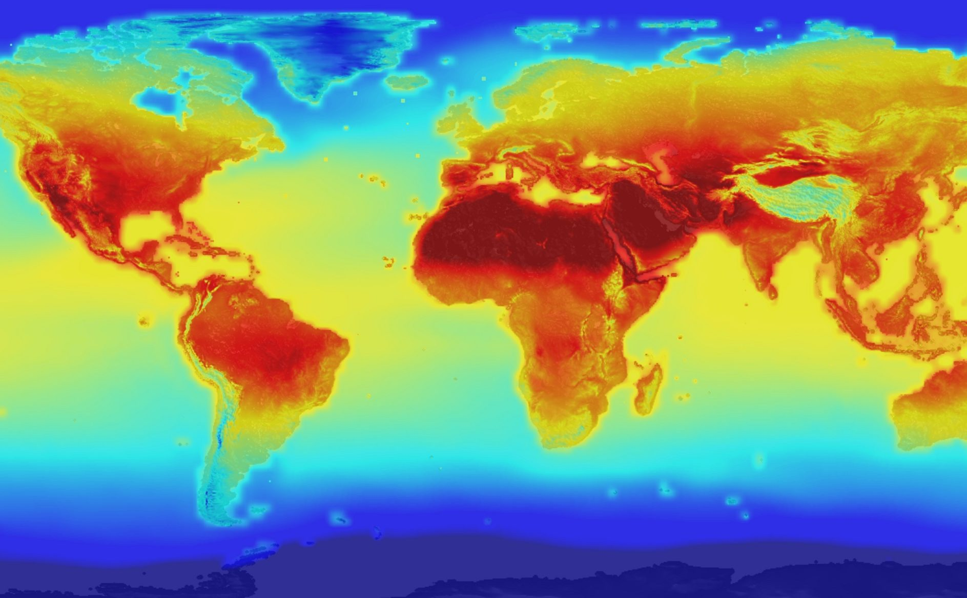
Overview
This Photo by Unknown Author is licensed under CC BY
The topic was selected due many factors:
Climate change and global warming
Power outages, wildfires, and other natural disasters
Increased greenhouse gas emissions
Increased interest in renewable energy specifically rooftop solar and energy storage.
Cost savings on electric

Slide 5
Questions We Hope to Answer with the Data
Based on the zip code,average electric rates the state incurs per kwh along with average cost of the the solar system installation, how many years does it take to breakeven on the cost?
When the user enters variables such as zip code and current electric bill does the global horizontal irradiance predict accurately for the zip code entered?
Team SunnyDay: Jacob Zebker, Kellen Schmitz, Chung In “Angel” Ngan, Angela Kumar

Slide 6
Description of the Data Exploration Phase
Difficult to find current data
Lots of sources for historical data
Data can be clean or messy depending on source
Hard to interconnect or select the features as there were a number of variables.

Slide 7
Description of the Data Exploration Phase
Read and Cleaned the DATA
Query, Add, Manipulate DATA
Storage of DATA
Machine Learning.
Excel
CSV
Python
Pandas
PostgreSQL
PgAdmin
SQLAlchemy
Data Visualization
Tableau
JavaScript
HTML/CSS
SciKitLearn Library
TensorFlow

Slide 8
Description of the Source of Data
The source data was primarily from Governmental Sources.
Electricity Rates by State -
https://www.eia.gov/electricity/state/
https://www.eia.gov/electricity/data/state/avgprice_annual.xlsx
Solar PV Supply Data -
https://www.nrel.gov/gis/solar-supply-curves.html
https://developer.nrel.gov/docs/solar/nsrdb/
US Zipcode Database –
https://www.unitedstateszipcodes.org/zip-code-database/
Team SunnyDay: Jacob Zebker, Kellen Schmitz, Chung In “Angel” Ngan, Angela Kumar

Slide 9
Tableau Visualization
Click Here
Team SunnyDay: Jacob Zebker, Kellen Schmitz, Chung In “Angel” Ngan, Angela Kumar

Slide 10
DATA Visualization Tableau
Energy Cost
Power Outages
Greenhouse Gases
Power Options: Sunlight
Chung In Ngan “Angel”
Team SunnyDay: Jacob Zebker, Kellen Schmitz, Chung In “Angel” Ngan, Angela Kumar

Slide 11
Description of the Analysis Phase
Solar System Installation Cost Analysis
Average Electric Cost Analysis
Breakeven Cost and Number of years that the installation will pay off.
Kellen Schmitz
Team SunnyDay: Jacob Zebker, Kellen Schmitz, Chung In “Angel” Ngan, Angela Kumar

Slide 12
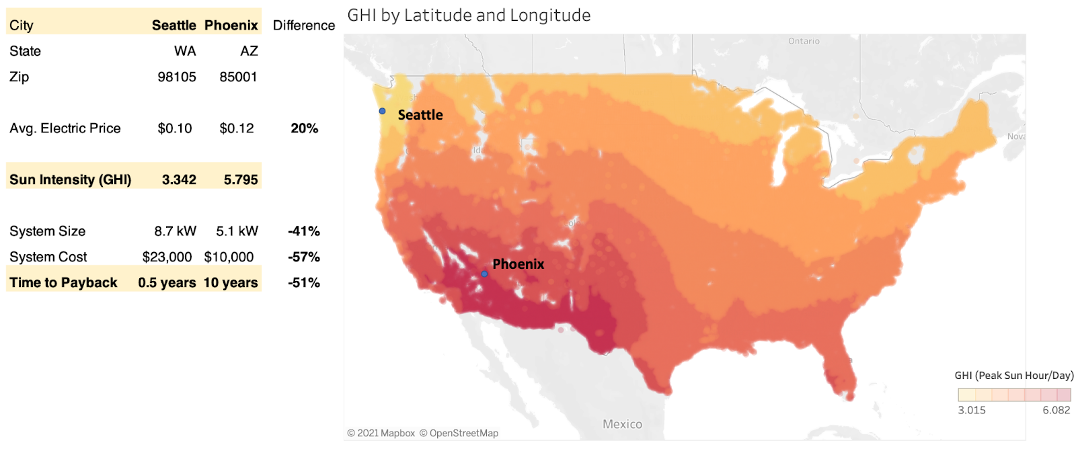
Description of the Analysis Phase

Slide 13
Machine Learning Prediction
Goal: Predict amount of time to pay back solar installation price from savings on electric bill
Potential solar energy
Electric price
Panel efficiency
Price
Jacob Zebker
Team SunnyDay: Jacob Zebker, Kellen Schmitz, Chung In “Angel” Ngan, Angela Kumar

Slide 14
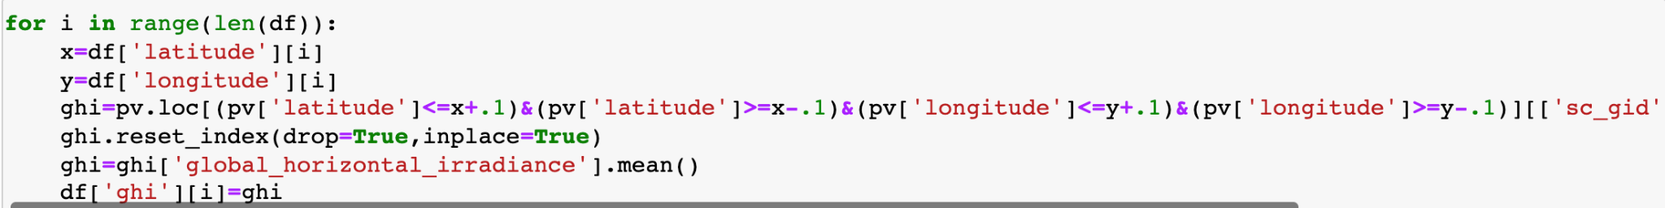
Big dataset
Conventional calculations are slow and unwieldy
Easily display accuracy value
WHY MACHINE LEARNING?
Team SunnyDay: Jacob Zebker, Kellen Schmitz, Chung In “Angel” Ngan, Angela Kumar

Slide 15
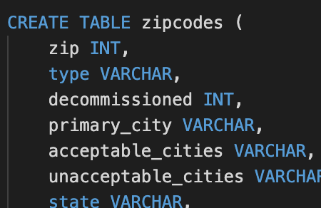
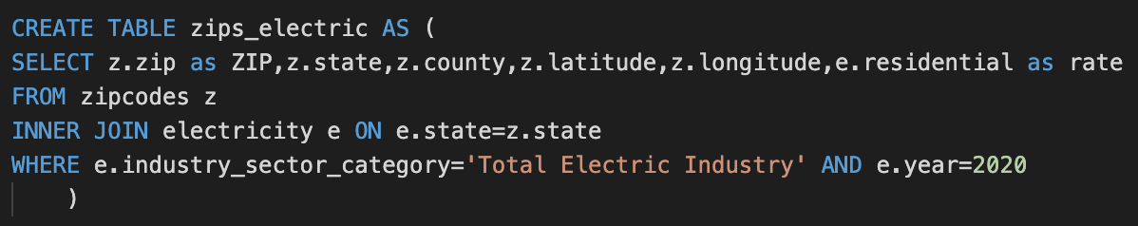
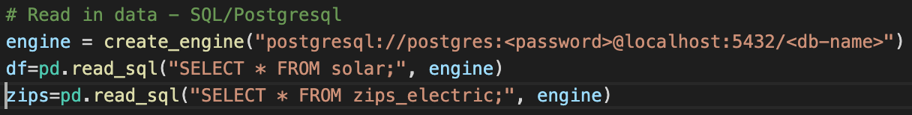
Description of the Data Exploration Phase
1) Read in data
2) SQL JOIN
3) Connect to model with SQLAlchemy
Team SunnyDay: Jacob Zebker, Kellen Schmitz, Chung In “Angel” Ngan, Angela Kumar

Slide 16
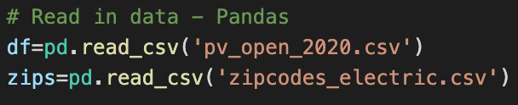
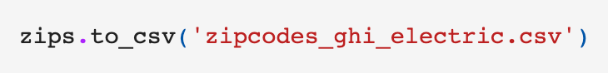
We can also do this with Pandas and CSV files
1) Pandas merge
2) Export CSV
3) Read in data
Team SunnyDay: Jacob Zebker, Kellen Schmitz, Chung In “Angel” Ngan, Angela Kumar

Slide 17
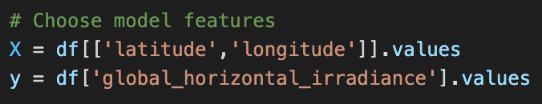
The Model
Random ⅓ of data used as test
Why RandomForestRegressor?
Large dataset
No need to extrapolate beyond US
Continuous data
R2 score?
Few outliers
Low variance from point to point
Zip Codes are not numeric data
Team SunnyDay: Jacob Zebker, Kellen Schmitz, Chung In “Angel” Ngan, Angela Kumar
Notes:
Why choose features? GHI is measured at different lat/lng so use the coords as features. Fill in gaps

Slide 18
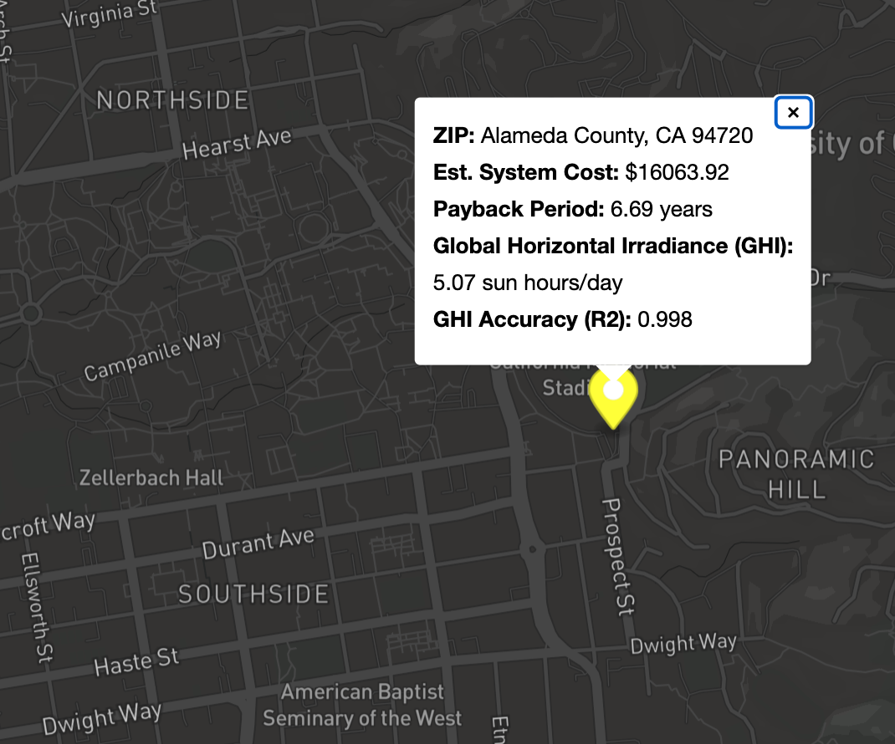
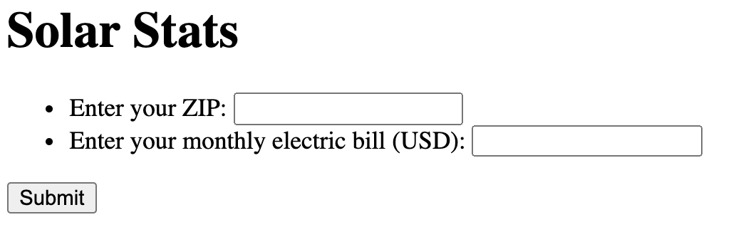
Flask App Demo
Sample Output
User Inputs
Team SunnyDay: Jacob Zebker, Kellen Schmitz, Chung In “Angel” Ngan, Angela Kumar
Notes:
Assumptions/Simplifications - For payback we have assumed solar makes electric bill go to zero
Uses latitude and longitude from center of zip
GHI values used are averages from annual measurement so we are not taking into account sun fluctuation throughout the year
Assuming monthly elec bill is 1/12 of yearly
Using constant elec rate for 2020 per state

Slide 19
Machine Learning Demo
Team SunnyDay: Jacob Zebker, Kellen Schmitz, Chung In “Angel” Ngan, Angela Kumar

Slide 20
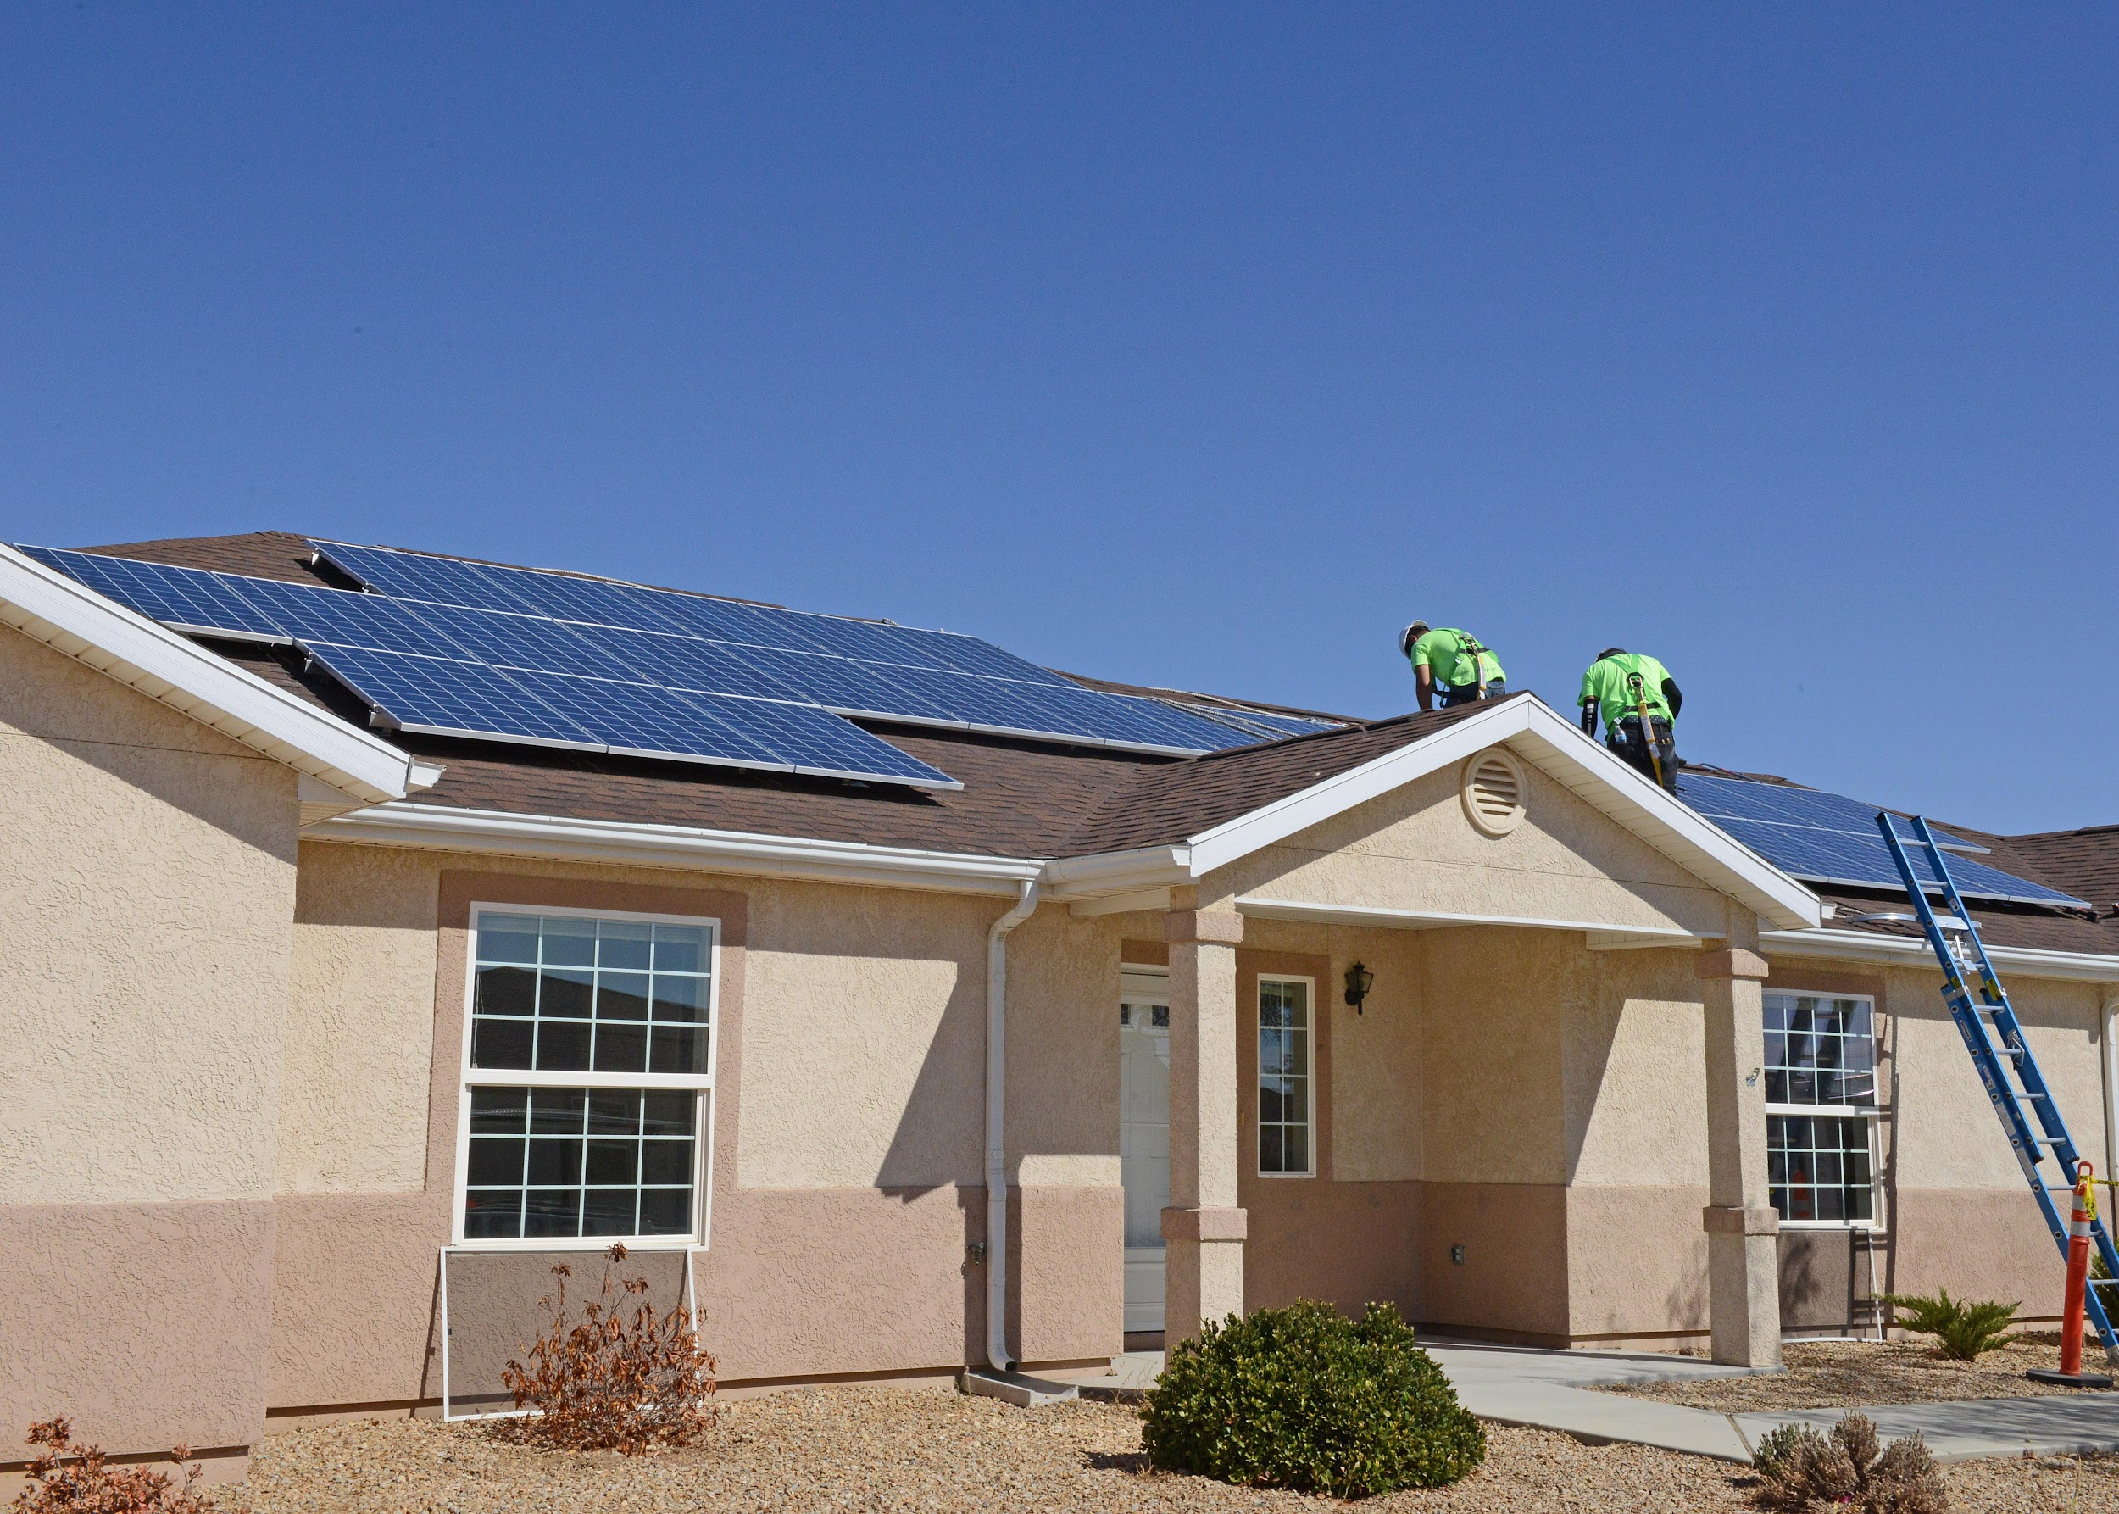
Summary of Our Finding as Team Sunny Day
Renewable energy such as solar, specifically photovoltaic panel installation can be used on the rooftop saves on electric savings.
Climate change is real and we need to do something about the planet.
Team SunnyDay: Jacob Zebker, Kellen Schmitz, Chung In “Angel” Ngan, Angela Kumar

Slide 21

Thank You
Thank you for your time
Team SunnyDay: Jacob Zebker, Kellen Schmitz, Chung In “Angel” Ngan, Angela Kumar

Slide 22

Questions? Concerns? Comments?
Team SunnyDay: Jacob Zebker, Kellen Schmitz, Chung In “Angel” Ngan, Angela Kumar

